Slide 1


Mohammad Naeimabadi
2024 Aug (08) 23

Slide 2

Outline
Executive Summary
Introduction
Methodology
Results
Conclusion
Appendix

Slide 3
Executive Summary
Summary of methodologies
Data collection
Data wrangling
Exploratory Data Analysis with Data Visualization
Exploratory Data Analysis with SQL
Building an interactive map with Folium
Building a Dashboard with Plotly Dash
Predictive analysis (Classification)
Summary of all results
Exploratory Data Analysis results
Interactive analytics demo in screenshots
Predictive analysis results

Slide 4
Introduction
Project background and context
The most prosperous business of the commercial space era, SpaceX has reduced the cost of space travel. On its website, the firm promotes Falcon 9 rocket flights, which start at 62 million dollars; in comparison, other suppliers charge up to 165 million dollars each launch; a large portion of the cost reductions are attributable to SpaceX's ability to reuse the first stage. Thus, we can calculate the cost of a launch if we can ascertain if the first stage will land. We are going to make a prediction on whether SpaceX will reuse the first stage based on publicly available data and learning algorithms.
Problems you want to find answers
What effects do factors like cargo mass, orbit, number of flights, and launch site have on the first stage landing's success?
Does the success rate of landings rise with time?
Which method works best in this situation for binary classification?

Slide 5

Section 1

Slide 6
Methodology
Executive Summary
Data collection methodology:
Using SpaceX Rest API
Using Web Scrapping from Wikipedia
Perform data wrangling
Filtering the data
Dealing with missing values
Using One Hot Encoding to prepare the data to a binary classification
Perform exploratory data analysis (EDA) using visualization and SQL
Perform interactive visual analytics using Folium and Plotly Dash
Perform predictive analysis using classification models
constructing, adjusting, and assessing categorization models to guarantee optimal outcomes

Slide 7
Data Collection
A mix of web scraping data from a table in SpaceX's Wikipedia article and API queries from the company's REST API were used in the data collecting procedure.
In order to obtain comprehensive information about the launches for a more in-depth analysis, we had to employ both of these data collection techniques.
SpaceX REST API is used to get Data Columns:
FlightNumber, LaunchSite, Orbit, BoosterVersion, PayloadMass, Outcome, Flights, GridFins, Block, ReusedCount, Serial, Longitude, Latitude, and Unused
Data Columns are acquired by the use of web scraping on Wikipedia:
Launch site, flight number, payload mass, orbit, customer, launch result, version booster, booster landing, date, and time

Slide 8
Decoding the response content using .json() and turning it into a dataframe using
.json_normalize()
Requesting needed information about the launches from SpaceX API
by applying custom functions
Requesting rocket launch data from SpaceX API
Constructing data we have obtained into a dictionary
Replacing missing values of Payload Mass column with calculated .mean() for this column
Filtering the dataframe to only include Falcon 9 launches
Exporting the data to CSV
Creating a dataframe from the dictionary
GitHub URL: https://github.com/pymamad/IBM-Applied-Data-Science-Capstone/blob/21c41626ded8f2cbe4751f201a0d422575f8dc62/jupyter-labs-spacex-data-collection-api.ipynb

Slide 9
Data Collection - Scraping
Requesting Falcon 9 launch data from Wikipedia
Creating a BeautifulSoup object from the HTML response
Extracting
all column names from the HTML table header
Collecting the data by parsing HTML tables
Exporting the data to CSV
Creating a dataframe from the dictionary
Constructing data we have obtained into a dictionary
GitHub URL: https://github.com/pymamad/IBM-Applied-Data-Science-Capstone/blob/21c41626ded8f2cbe4751f201a0d422575f8dc62/jupyter-labs-webscraping.ipynb

Slide 10
Data Wrangling
In the data set, there are several different cases where the booster did not land successfully. Sometimes a landing was attempted but failed due to an accident; for example, True Ocean means the mission outcome was successfully landed to a specific region of the ocean while False Ocean means the mission outcome was unsuccessfully landed to a specific region of the ocean. True RTLS means the mission outcome was successfully landed to a ground pad False RTLS means the mission outcome was unsuccessfully landed to a ground pad.True ASDS means the mission outcome was successfully landed on a drone ship False ASDS means the mission outcome was unsuccessfully landed on a drone ship.
We mainly convert those outcomes into Training Labels with “1” means the booster successfully landed, “0” means it was unsuccessful.
Perform exploratory Data Analysis and determine Training Labels
Calculate the number of launches on each site
Calculate the number and occurrence of each orbit
Calculate the number and occurrence of mission outcome per orbit type
Create a landing outcome label from Outcome column
Exporting the data to CSV
GitHub URL: https://github.com/pymamad/IBM-Applied-Data-Science-Capstone/blob/21c41626ded8f2cbe4751f201a0d422575f8dc62/labs-jupyter-spacex-Data%20wrangling.ipynb

Slide 11
EDA with Data Visualization
Flight Number vs. Payload Mass, Flight Number vs. Launch Site, Payload Mass vs. Launch Site, Orbit Type vs. Success Rate, Flight Number vs. Orbit Type, Payload Mass vs Orbit Type and Success Rate Yearly Trend
Scatter plots show the relationship between variables. If a relationship exists, they could be used in machine learning model.
Bar charts show comparisons among discrete categories. The goal is to show the relationship between the specific categories being compared and a measured value.
Line charts show trends in data over time (time series).
GitHub URL: https://github.com/pymamad/IBM-Applied-Data-Science-Capstone/blob/21c41626ded8f2cbe4751f201a0d422575f8dc62/jupyter-labs-eda-sql-coursera_sqllite.ipynb

Slide 12
EDA with SQL
Performed SQL queries:
Displaying the names of the unique launch sites in the space mission
Displaying 5 records where launch sites begin with the string ‘CCA'
Displaying the total payload mass carried by boosters launched by NASA (CRS)
Displaying average payload mass carried by booster version F9 v1.1
Listing the date when the first successful landing outcome in ground pad was achieved
Listing the names of the boosters which have success in drone ship and have payload mass greater than 4000 but less than 6000
Listing the total number of successful and failure mission outcomes
Listing the names of the booster versions which have carried the maximum payload mass
Listing the failed landing outcomes in drone ship, their booster versions and launch site names for the months in year 2015
Ranking the count of landing outcomes (such as Failure (drone ship) or Success (ground pad)) between the date 2010-06-04 and 2017-03-20 in descending order
GitHub URL: https://github.com/pymamad/IBM-Applied-Data-Science-Capstone/blob/21c41626ded8f2cbe4751f201a0d422575f8dc62/edadataviz.ipynb

Slide 13
Build an Interactive Map with Folium
Markers of all Launch Sites:
Added Marker with Circle, Popup Label and Text Label of NASA Johnson Space Center using its latitude and longitude coordinates as a start location.
Added Markers with Circle, Popup Label and Text Label of all Launch Sites using their latitude and longitude coordinates to show their geographical locations and proximity to Equator and coasts.
Coloured Markers of the launch outcomes for each Launch Site:
Added coloured Markers of success (Green) and failed (Red) launches using Marker Cluster to identify which launch sites have relatively high success rates.
Distances between a Launch Site to its proximities:
Added coloured Lines to show distances between the Launch Site KSC LC-39A (as an example) and its proximities like Railway, Highway, Coastline and Closest City.
GitHub URL: https://github.com/pymamad/IBM-Applied-Data-Science-Capstone/blob/21c41626ded8f2cbe4751f201a0d422575f8dc62/lab_jupyter_launch_site_location.ipynb

Slide 14
Launch Sites Dropdown List:
Build a Dashboard with Plotly Dash
Added a dropdown list to enable Launch Site selection.
Pie Chart showing Success Launches (All Sites/Certain Site):
Added a pie chart to show the total successful launches count for all sites and the Success vs. Failed counts for the site, if a specific Launch Site was selected.
Slider of Payload Mass Range:
Added a slider to select Payload range.
Scatter Chart of Payload Mass vs. Success Rate for the different Booster Versions:
Added a scatter chart to show the correlation between Payload and Launch Success.
GitHub URL: https://github.com/pymamad/IBM-Applied-Data-Science-Capstone/blob/21c41626ded8f2cbe4751f201a0d422575f8dc62/spacex_dash_app.py

Slide 15
Predictive Analysis (Classification)
Standardizing the data with StandardScaler, then fitting and transforming it
Splitting the data into training and testing sets with train_test_split function
Creating a GridSearchCV object with cv = 10 to find the best parameters
Creating a NumPy array from the column “Class” in data
Finding the method performs best by examining the Jaccard_score and F1_score metrics
Calculating the accuracy on the test data using the method .score()
for all models
Applying GridSearchCV on LogReg, SVM,
Decision Tree, and KNN models
Examining the confusion matrix for all models
GitHub URL: https://github.com/pymamad/IBM-Applied-Data-Science-Capstone/blob/21c41626ded8f2cbe4751f201a0d422575f8dc62/SpaceX_Machine%20Learning%20Prediction_Part_5.ipynb

Slide 16
Results
Exploratory data analysis results
Interactive analytics demo in screenshots
Predictive analysis results

Slide 17

Section 2

Slide 18
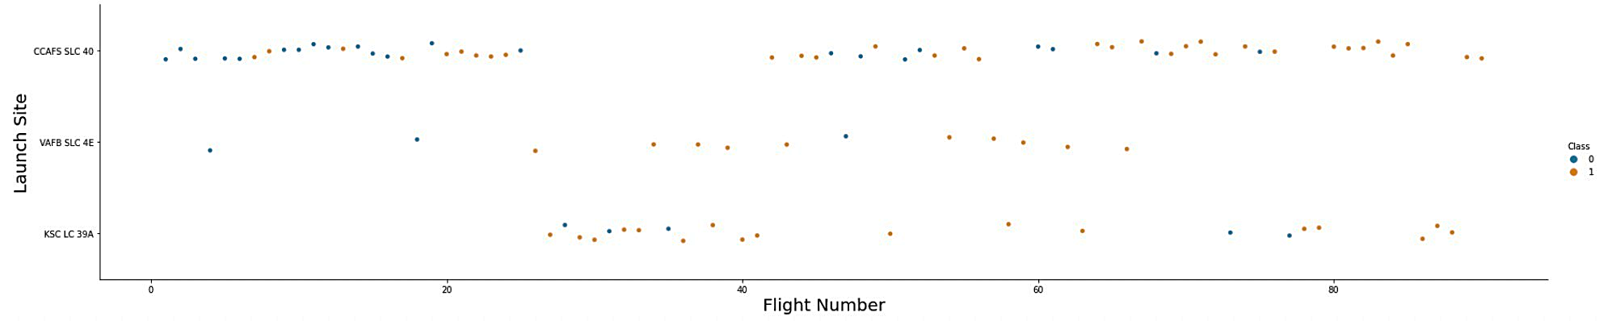
Flight Number vs. Launch Site
Explanation:
The earliest flights all failed while the latest flights all succeeded.
The CCAFS SLC 40 launch site has about a half of all launches.
VAFB SLC 4E and KSC LC 39A have higher success rates.
It can be assumed that each new launch has a higher rate of success.

Slide 19
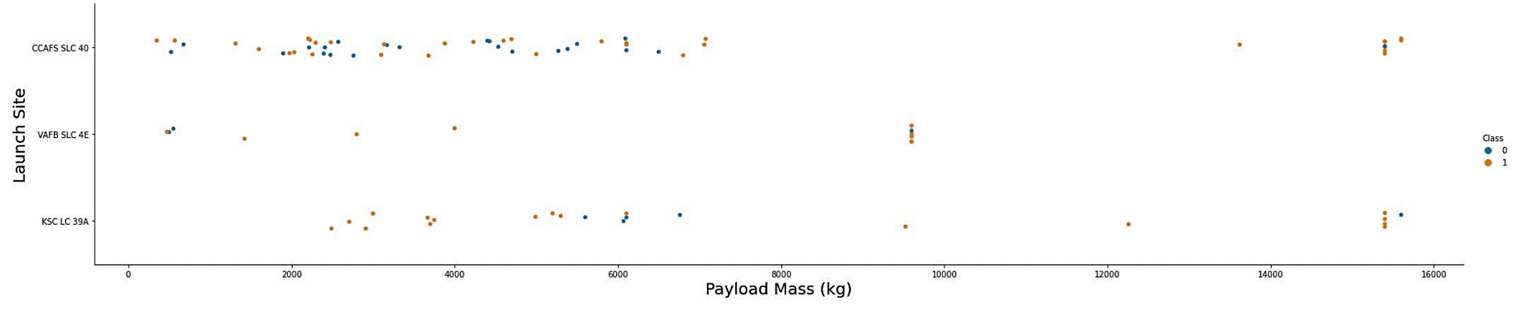
Payload vs. Launch Site
Explanation:
For every launch site the higher the payload mass, the higher the success rate.
Most of the launches with payload mass over 7000 kg were successful.
KSC LC 39A has a 100% success rate for payload mass under 5500 kg too.

Slide 20
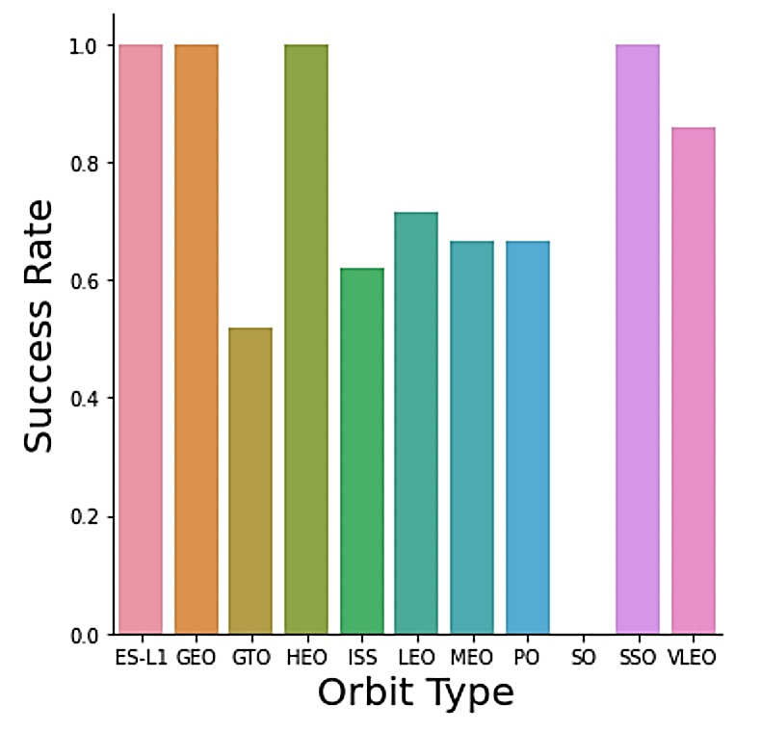
Explanation:
Success Rate vs. Orbit Type
Orbits with 100% success rate:
ES-L1, GEO, HEO, SSO
Orbits with 0% success rate:
SO
Orbits with success rate between 50% and 85%:
GTO, ISS, LEO, MEO, PO

Slide 21
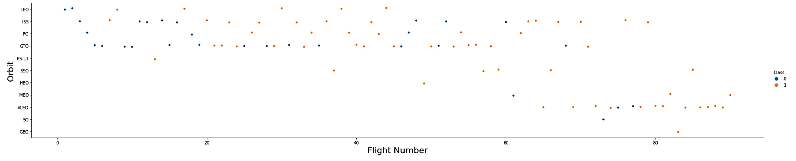
Flight Number vs. Orbit Type
Explanation:
In the LEO orbit the Success appears related to the number of flights; on the other hand, there seems to be no relationship between flight number when in GTO orbit.

Slide 22
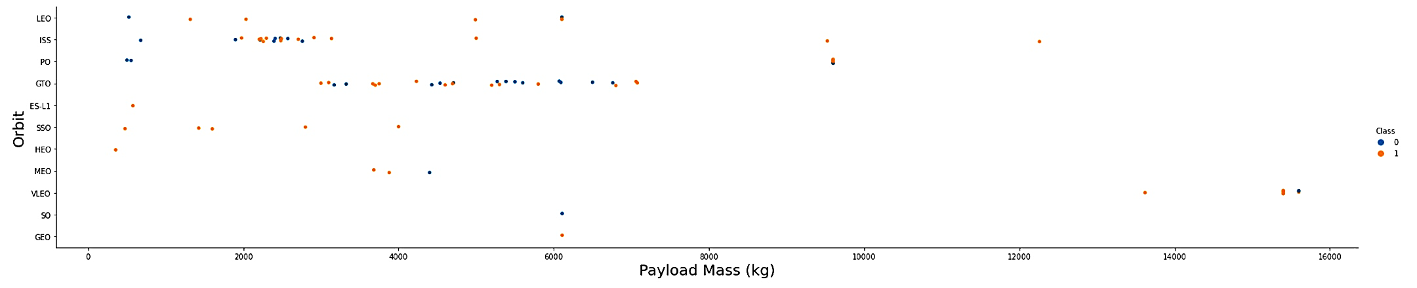
Payload vs. Orbit Type
Explanation:
Heavy payloads have a negative influence on GTO orbits and positive on GTO and Polar LEO (ISS) orbits.

Slide 23
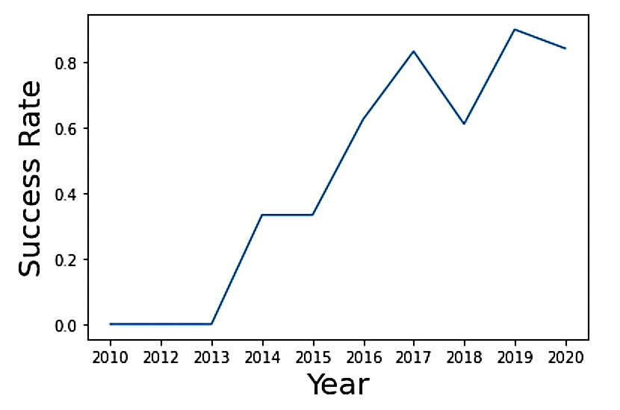
Explanation:
Launch Success Yearly Trend
The success rate since 2013 kept
increasing till 2020.

Slide 24
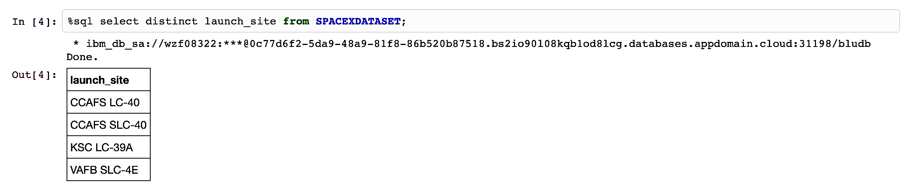
All Launch Site Names
Explanation:
Displaying the names of the unique launch sites in the space mission.

Slide 25
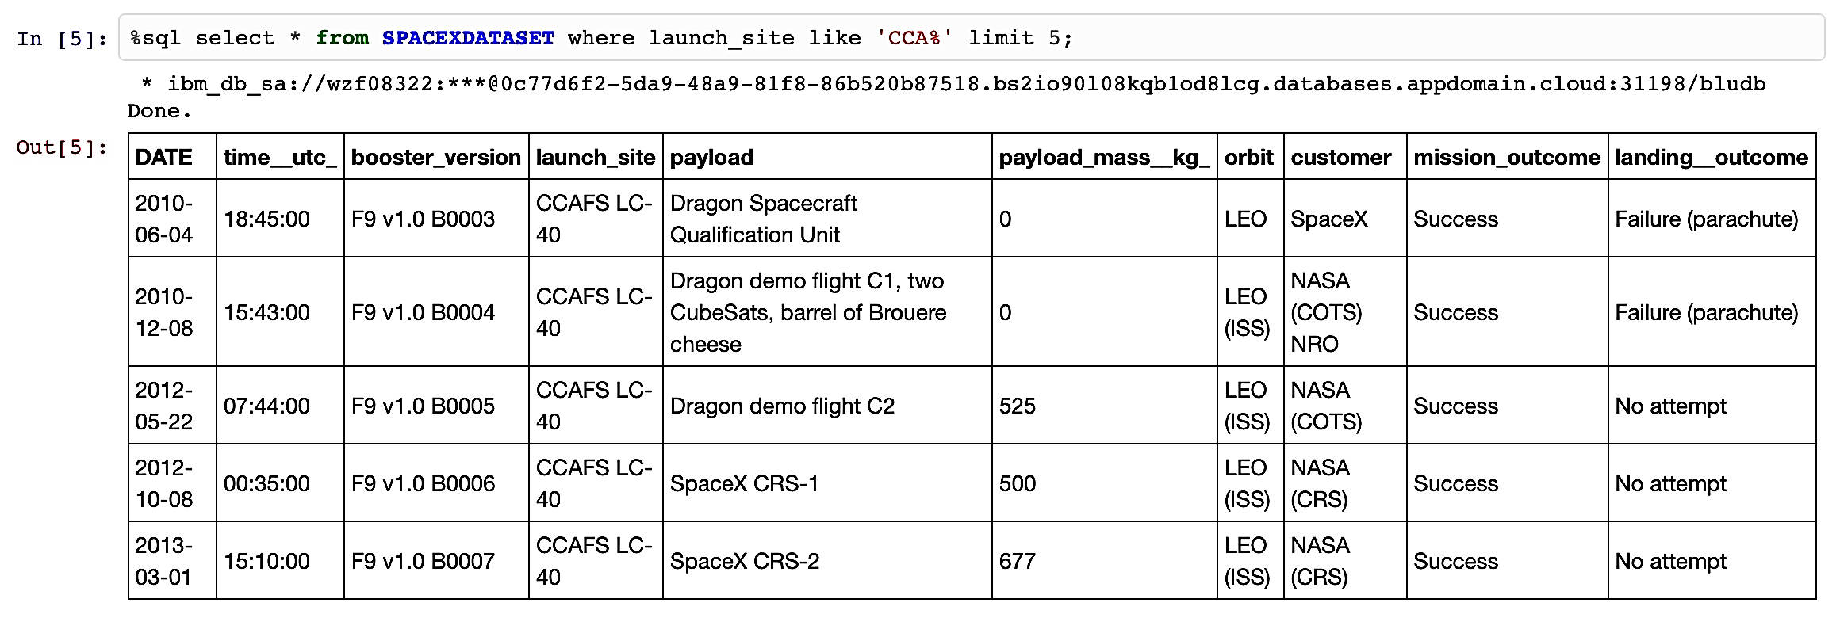
Launch Site Names Begin with 'CCA'
Explanation:
Displaying 5 records where launch sites begin with the string 'CCA'.

Slide 26
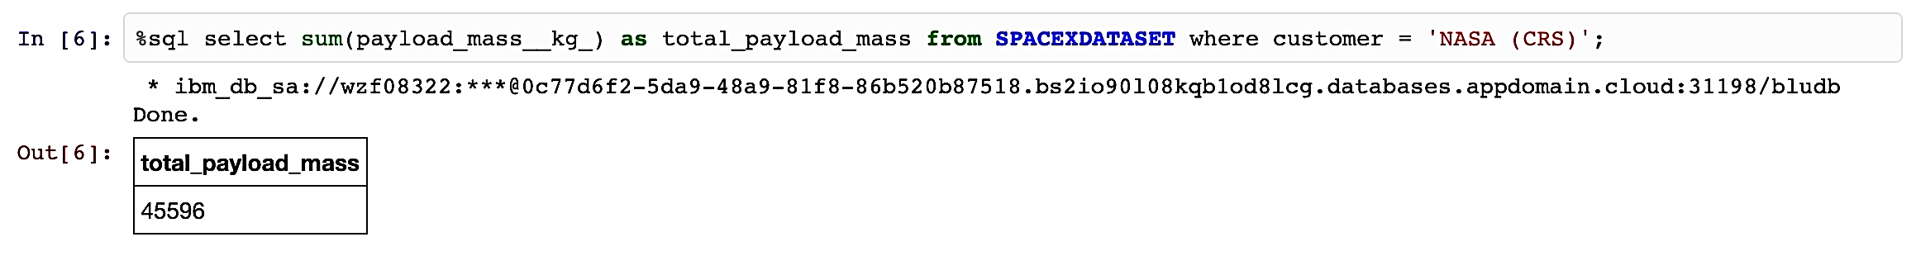
Total Payload Mass
Explanation:
Displaying the total payload mass carried by boosters launched by NASA (CRS).

Slide 27
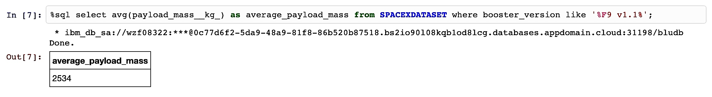
Average Payload Mass by F9 v1.1
Explanation:
Displaying average payload mass carried by booster version F9 v1.1.

Slide 28
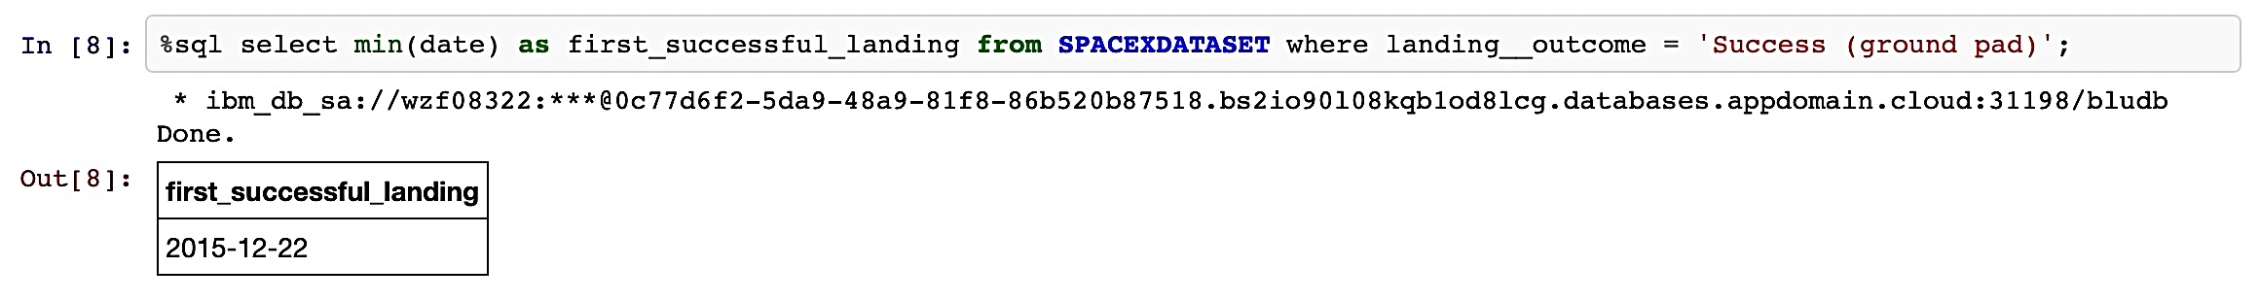
First Successful Ground Landing Date
Explanation:
Listing the date when the first successful landing outcome in ground pad was achieved.

Slide 29
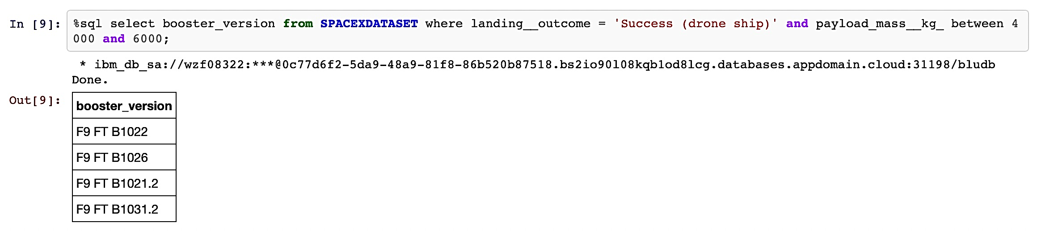
Successful Drone Ship Landing with Payload between 4000 and 6000
Explanation:
Listing the names of the boosters which have success in drone ship and have payload mass greater than 4000 but less than 6000.

Slide 30
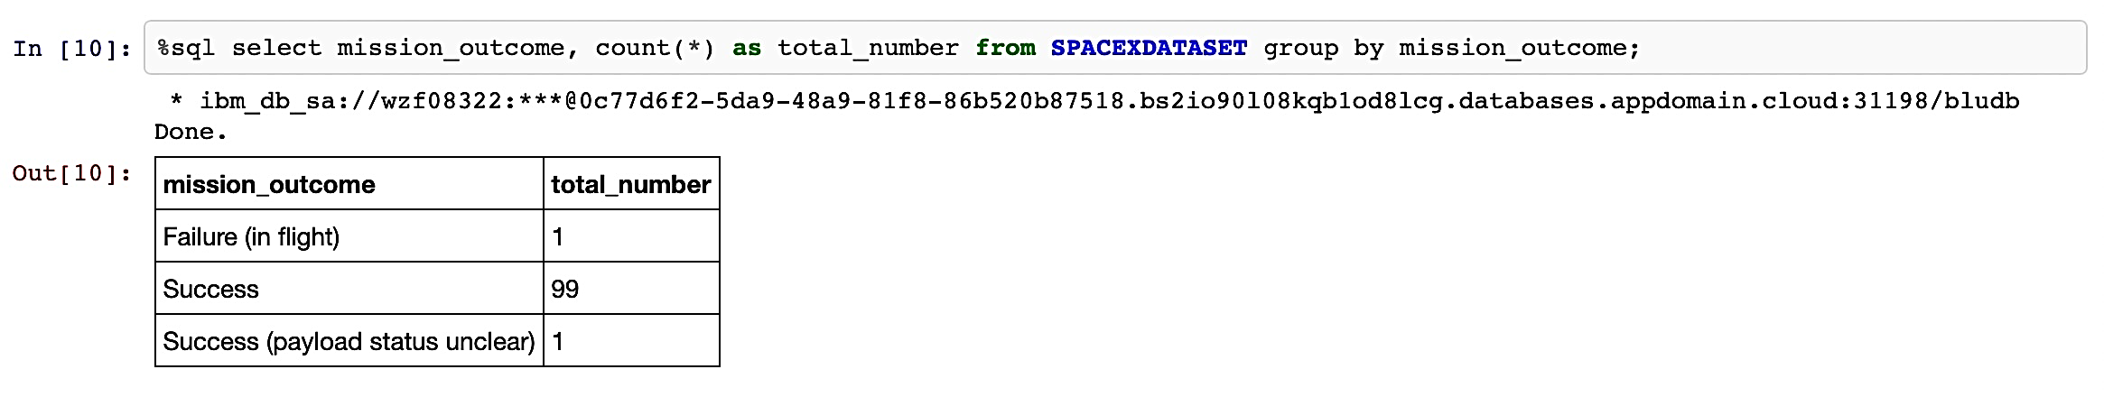
Total Number of Successful and Failure Mission Outcomes
Explanation:
Listing the total number of successful and failure mission outcomes.

Slide 31
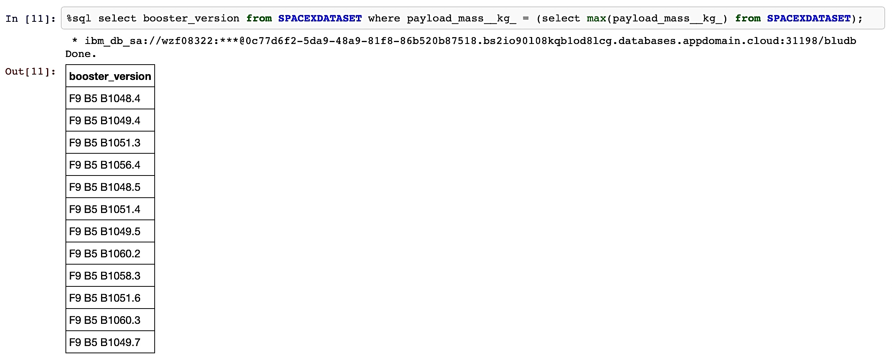
Boosters Carried Maximum Payload
Explanation:
Listing the names of the booster versions which have carried the maximum payload mass.

Slide 32
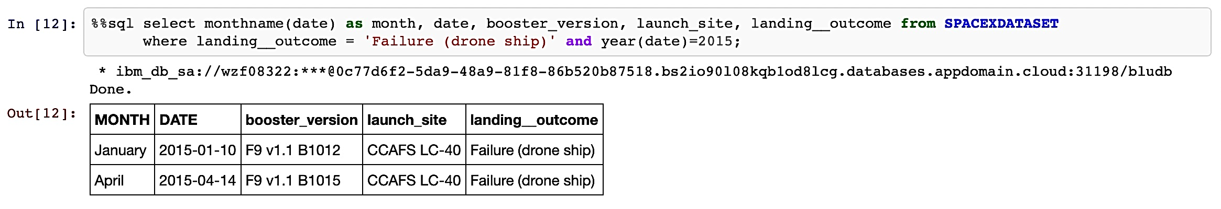
2015 Launch Records
Explanation:
Listing the failed landing outcomes in drone ship, their booster versions and launch site names for the months in year 2015.

Slide 33
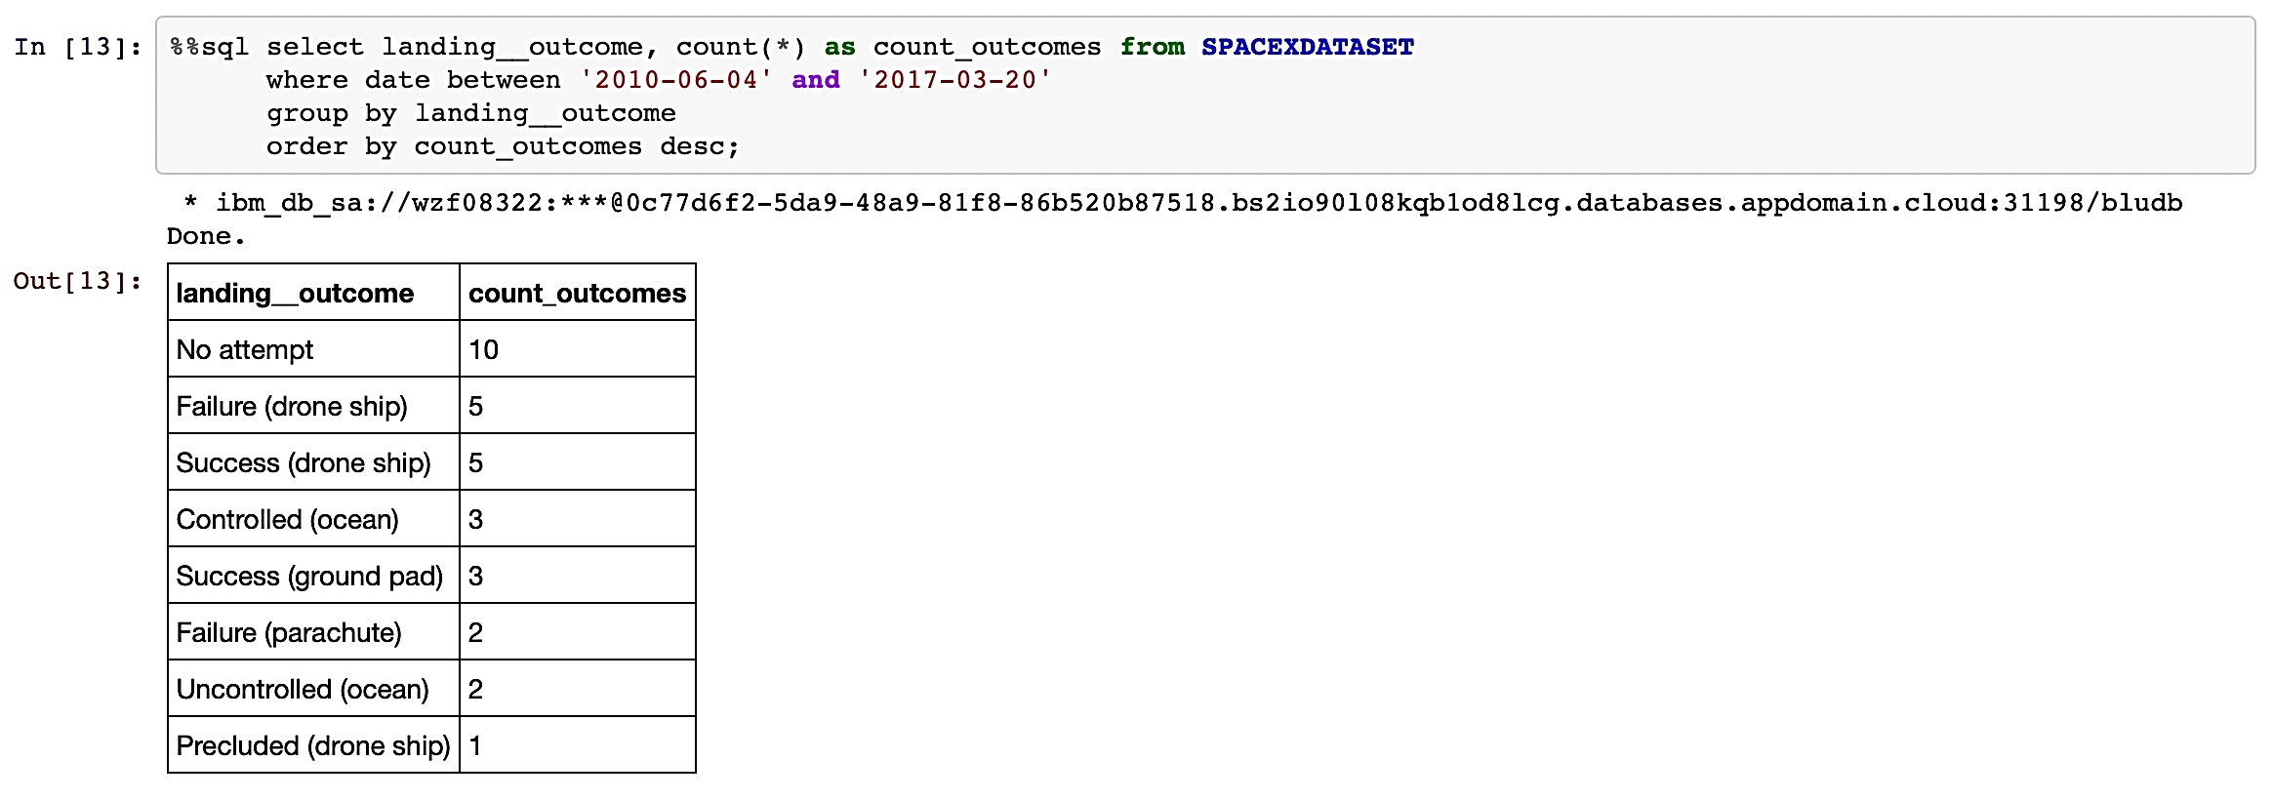
Rank Landing Outcomes Between 2010-06-04 and 2017-03-20
Explanation:
Ranking the count of landing outcomes (such as Failure (drone ship) or Success (ground pad)) between the date 2010-06-04 and 2017-03-20 in descending order.

Slide 34

Section 3

Slide 35
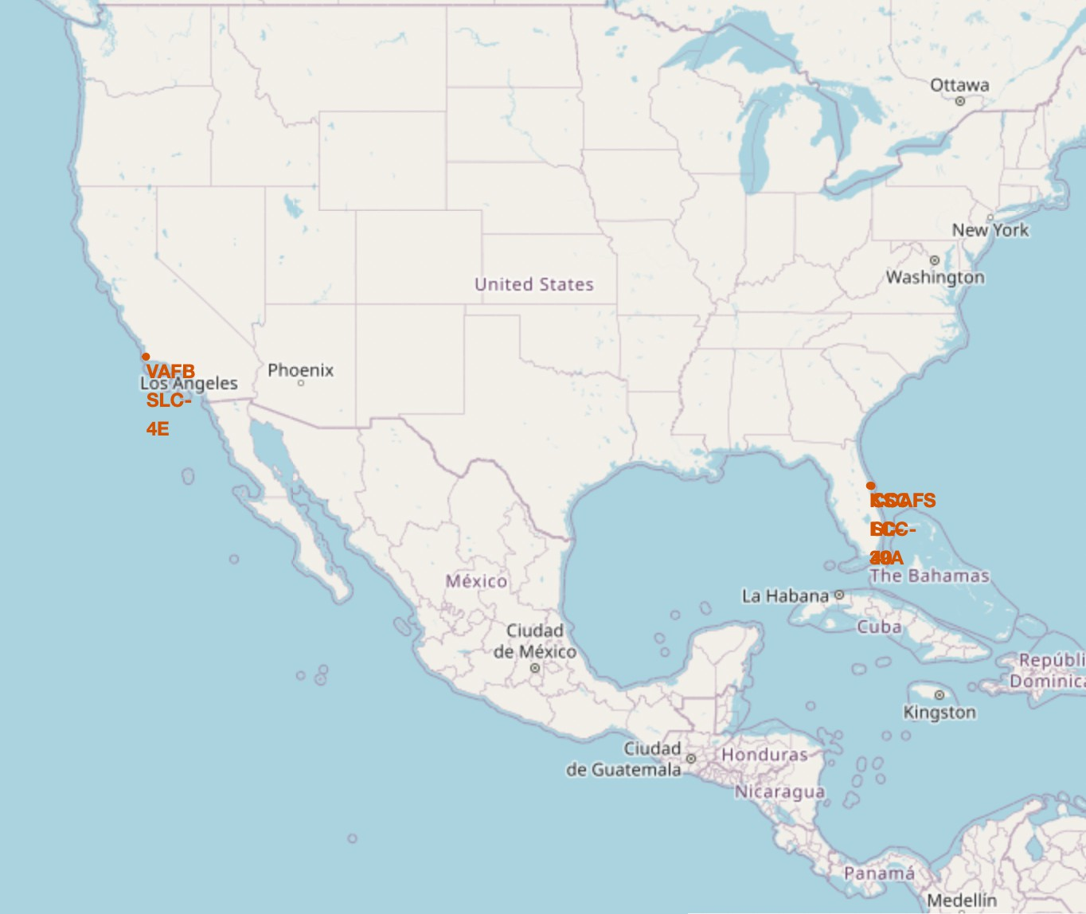
All launch sites location makers on a global map
Explanation:
Most of Launch sites are in proximity to the Equator line. The land is moving faster at the equator than any other place on the surface of the Earth. Anything on the surface of the Earth at the equator is already moving at 1670 km/hour. If a ship is launched from the equator it goes up into space, and it is also moving around the Earth at the same speed it was moving before launching. This is because of inertia. This speed will help the spacecraft keep up a good enough speed to stay in orbit.
All launch sites are in very close proximity to the coast, while launching rockets towards the ocean it minimises the risk of having any debris dropping or exploding near people.

Slide 36
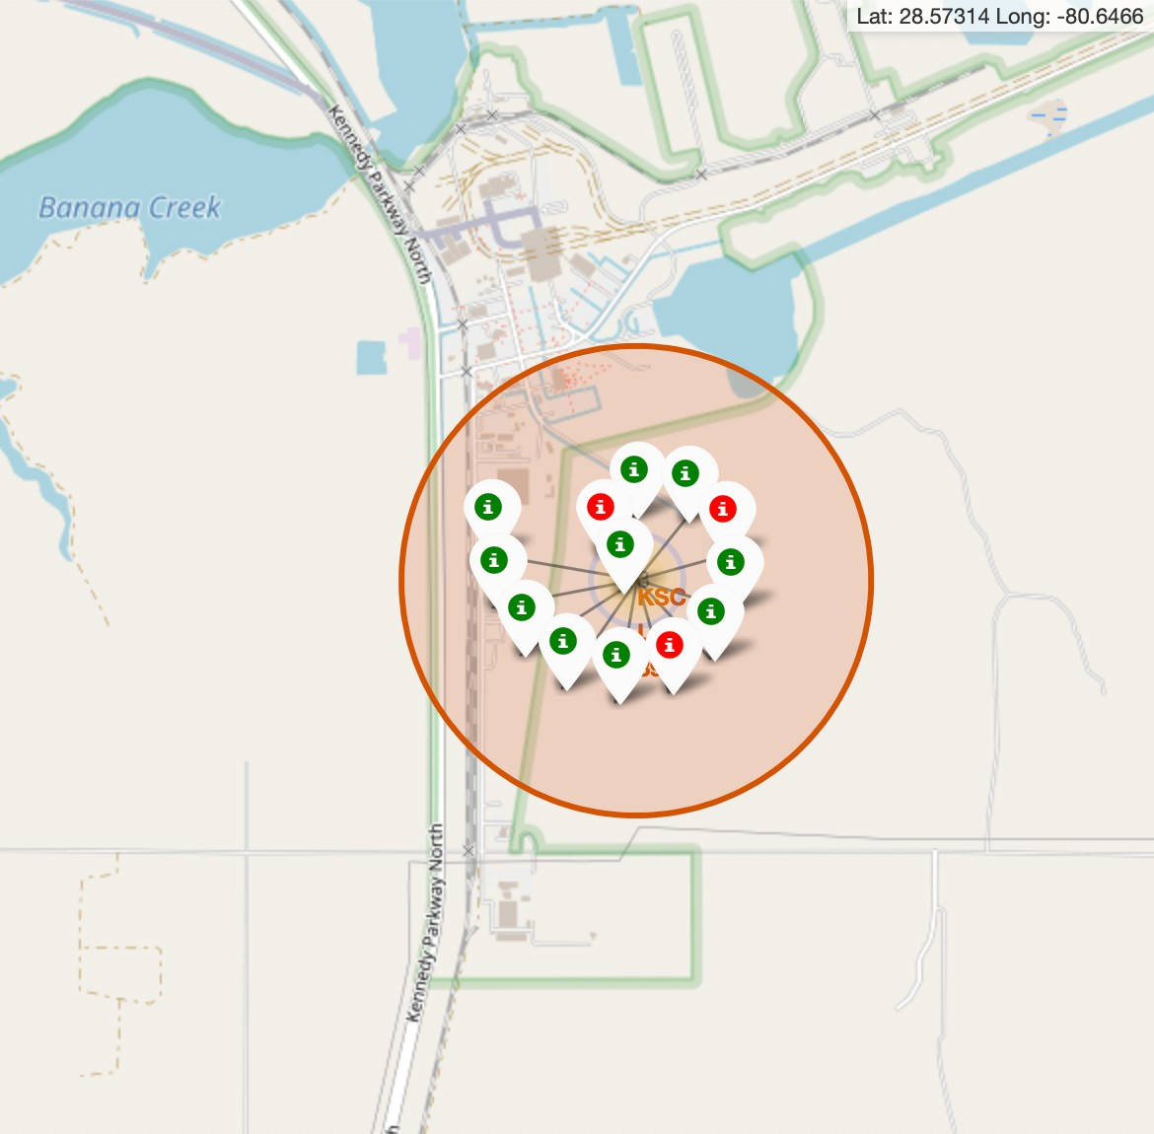
Explanation:
Color – labeled launch records on the map
From the colour-labeled markers we should be able to easily identify which launch sites have relatively high success rates.
Green Marker = Successful Launch
Red Marker = Failed Launch
Launch Site KSC LC-39A has a very high Success Rate.

Slide 37
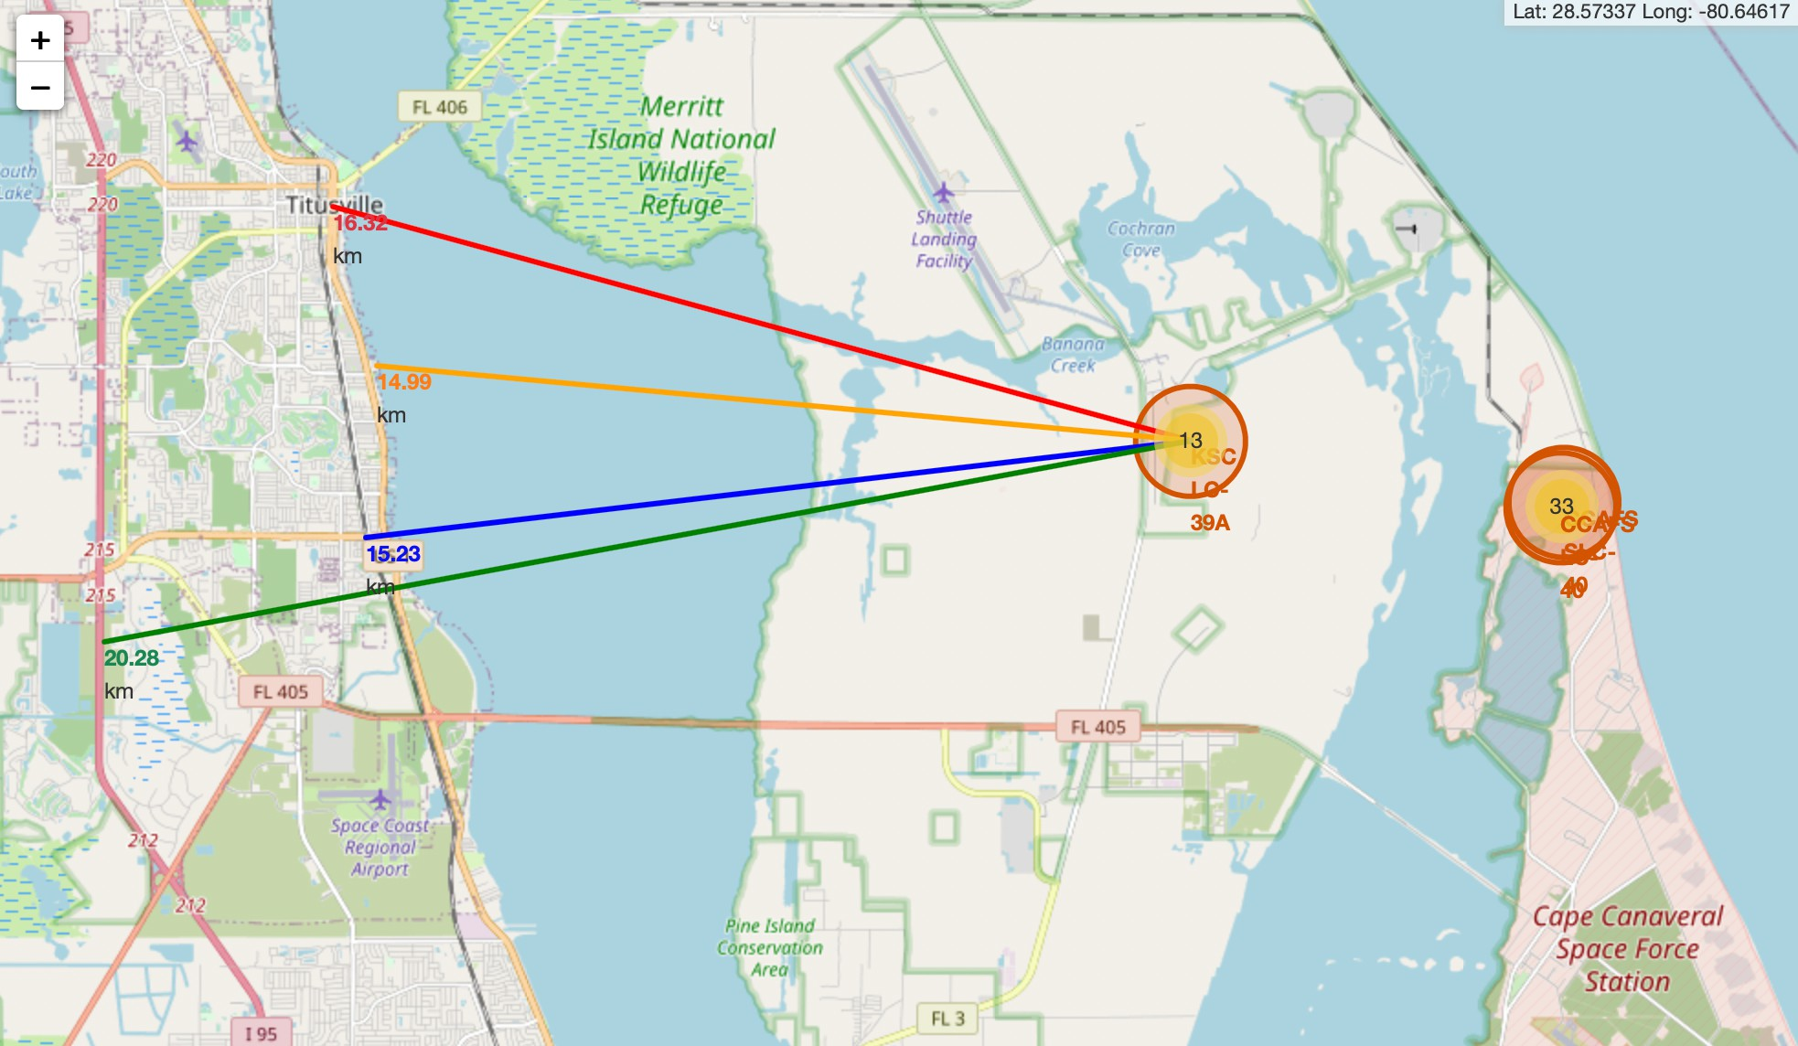
Distance from the launch site
KSC LC-39A to its proximates
Explanation:
From the visual analysis of the launch site KSC LC-39A we can clearly see that it is:
relative close to railway (15.23 km)
relative close to highway (20.28 km)
relative close to coastline (14.99 km)
Also the launch site KSC LC-39A is relative close to its closest city Titusville (16.32 km).
Failed rocket with its high speed can cover distances like 15-20 km in few seconds. It could be potentially dangerous to populated areas.

Slide 38

Section 4

Slide 39
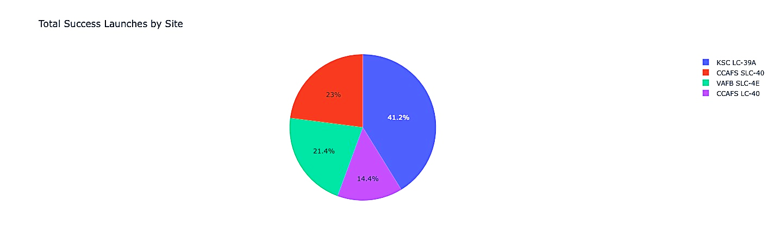
Launch success count for all sites
Explanation:
The chart clearly shows that from all the sites, KSC LC-39A has the most successful launches.

Slide 40
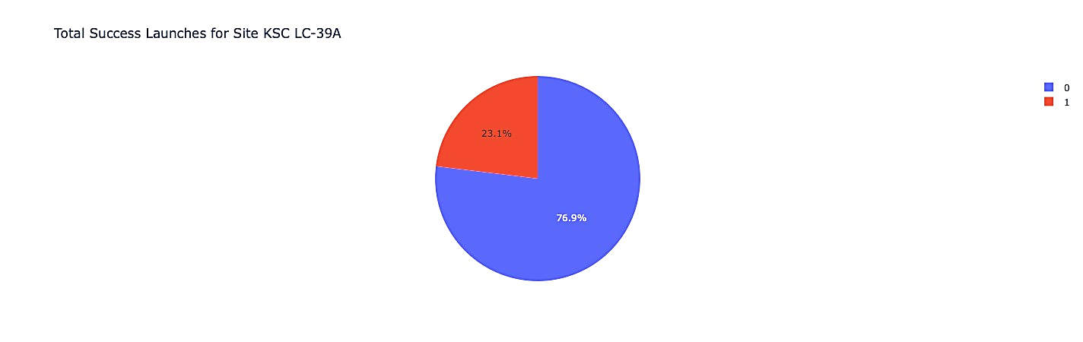
Launch site with highest launch success ratio
Explanation:
KSC LC-39A has the highest launch success rate (76.9%) with 10 successful and only 3 failed landings.

Slide 41
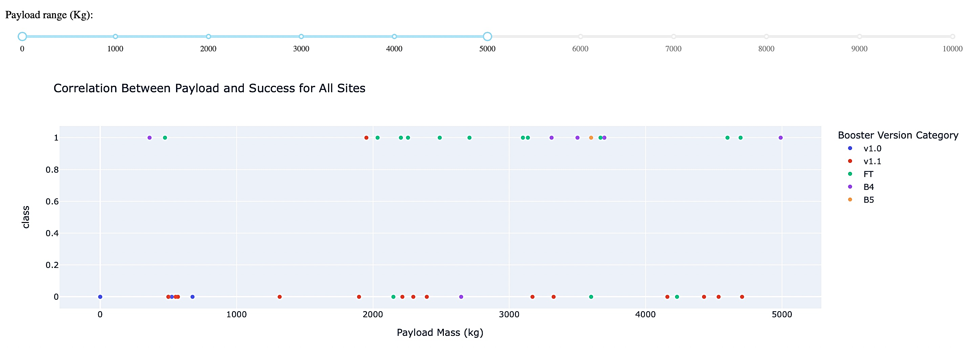
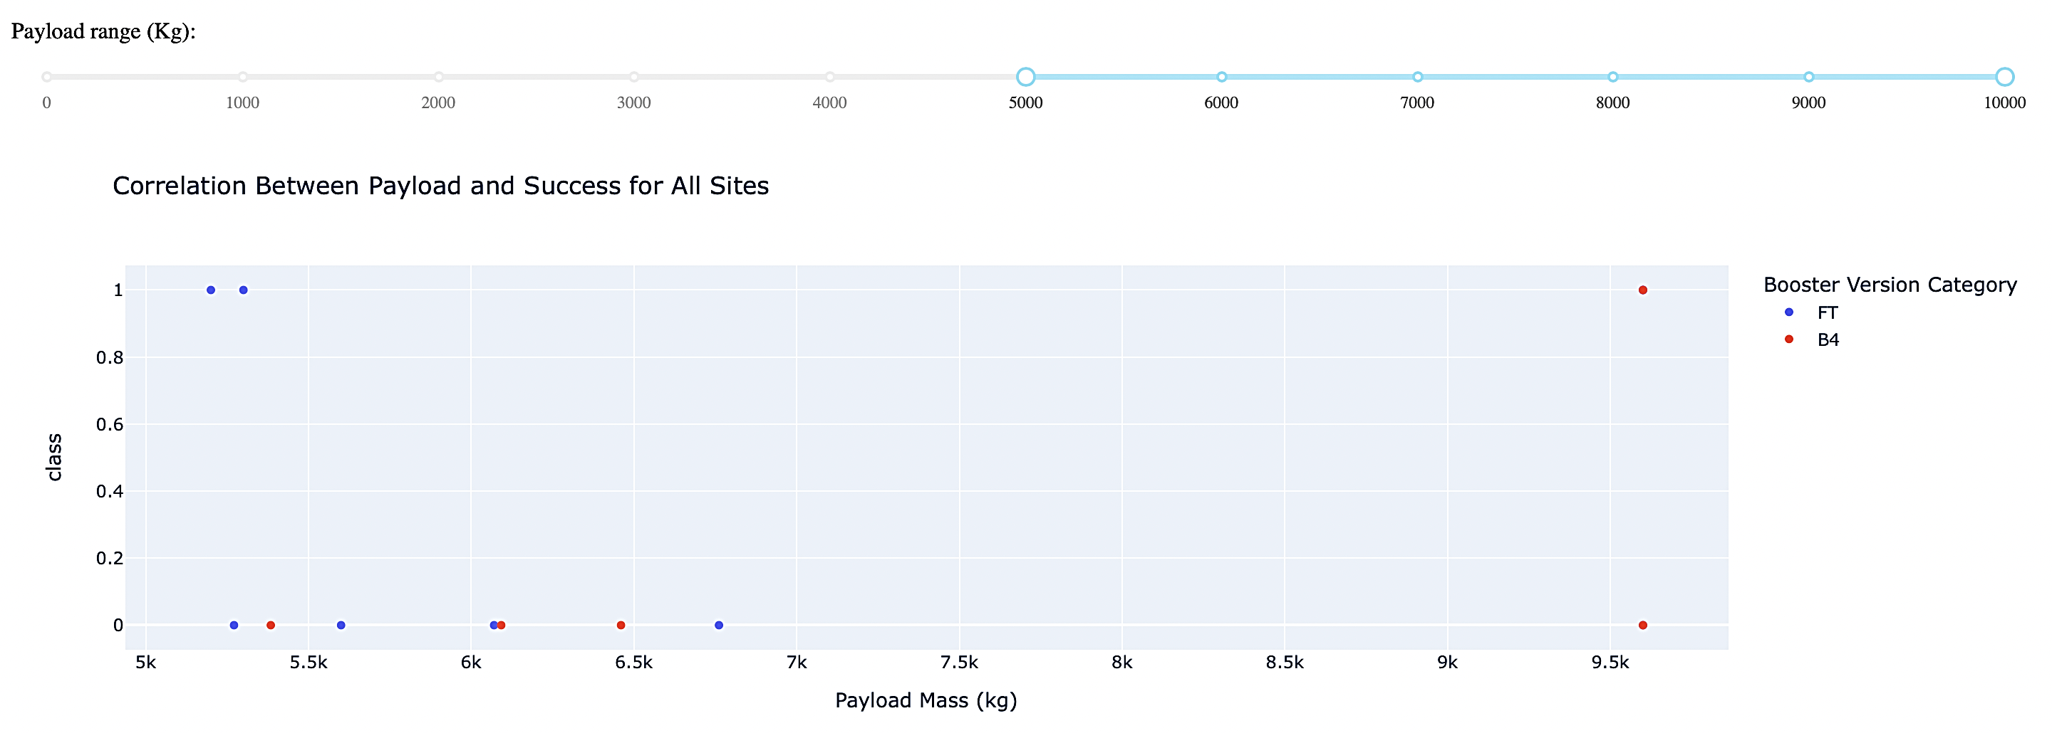
Explanation:
Payload mass vs. launch outcomes for all sites
The charts show that payloads between 2000 and 5500 kg have the highest success rate.

Slide 42

Section 5

Slide 43
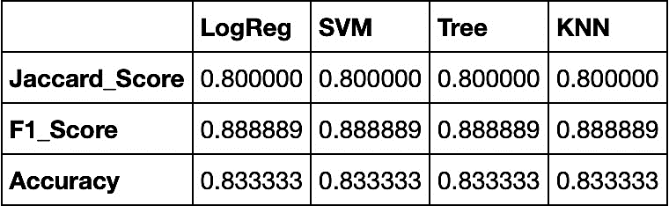
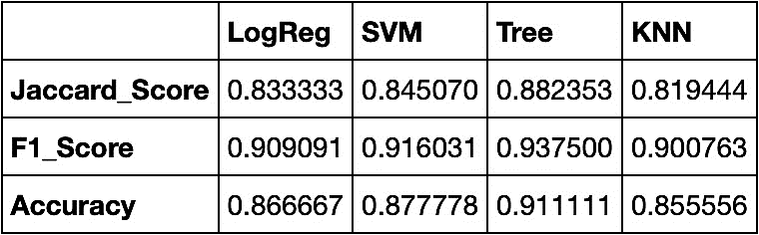
Scores and Accuracy of the Test Set
Classification Accuracy
Explanation:
Based on the scores of the Test Set, we can not confirm which method performs best.
Same Test Set scores may be due to the small test sample size (18 samples). Therefore, we tested all methods based on the whole Dataset.
The scores of the whole Dataset confirm that the best model is the Decision Tree Model. This model has not only higher scores, but also the highest accuracy.
Scores and Accuracy of the Entire Data Set

Slide 44
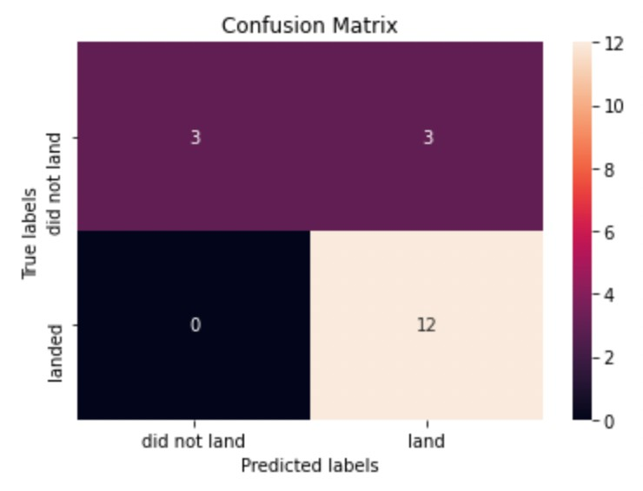
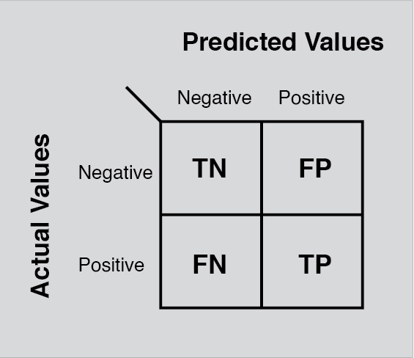
Explanation:
Confusion Matrix
Examining the confusion matrix, we see that logistic regression can distinguish between the different classes. We see that the major problem is false positives.

Slide 45
Conclusions
Decision Tree Model is the best algorithm for this dataset.
Launches with a low payload mass show better results than launches with a larger payload mass.
Most of launch sites are in proximity to the Equator line and all the sites are in very close proximity to the coast.
The success rate of launches increases over the years.
KSC LC-39A has the highest success rate of the launches from all the sites.
Orbits ES-L1, GEO, HEO and SSO have 100% success rate

Slide 46
Appendix
Special Thanks to:
Instructors
Coursera
IBM

Slide 47


